Slide 1
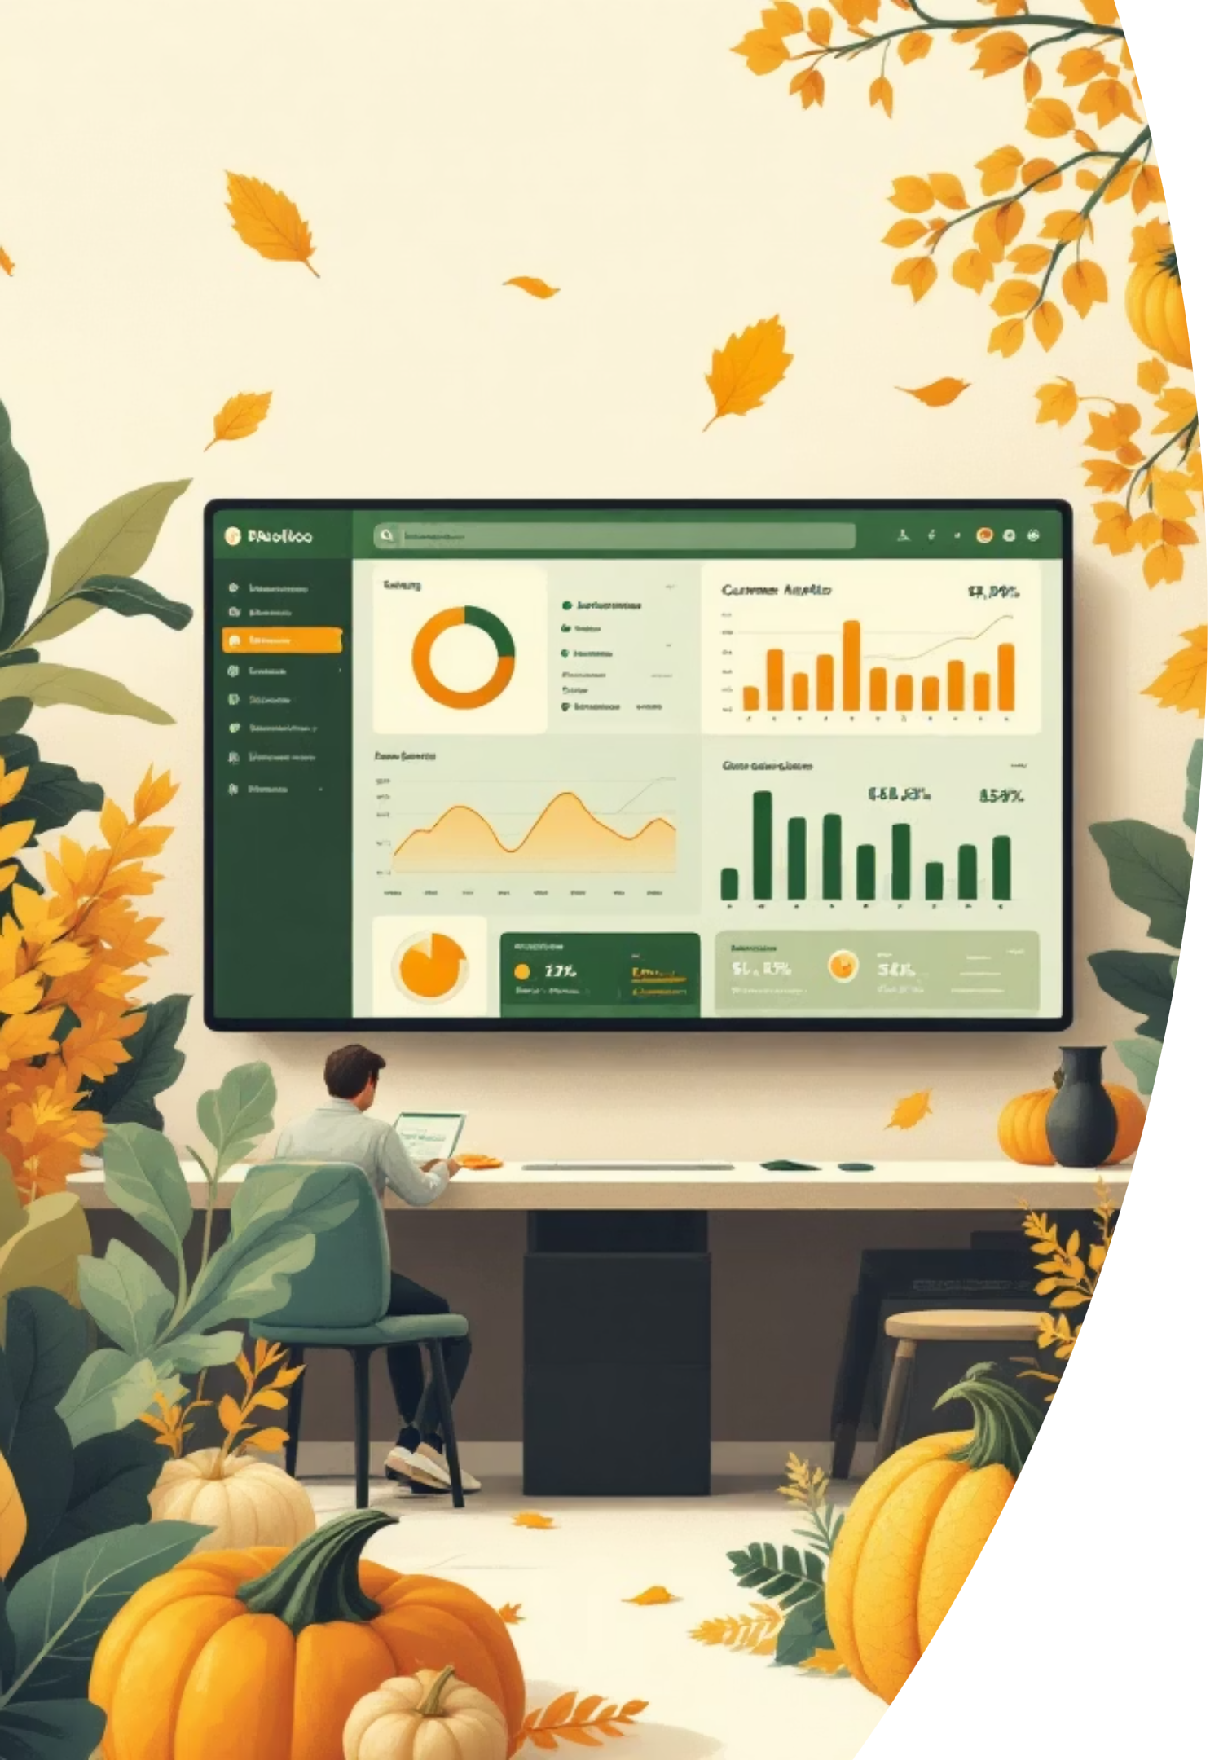
Customer Behavior Analysis Dashboard
Prepared by Bhaskar Kushwah — tools: Python (pandas), PostgreSQL, PowerBI. Interactive dashboard to surface purchasing patterns, revenue by category, subscription impact, and high-value age groups.

Slide 2

Project Overview
Purpose
Focus
Analyze customer purchasing patterns and revenue distribution by category.
Evaluate subscription impact and identify high-value age groups.
Output
Interactive PowerBI dashboard for segmentation and insights.

Slide 3
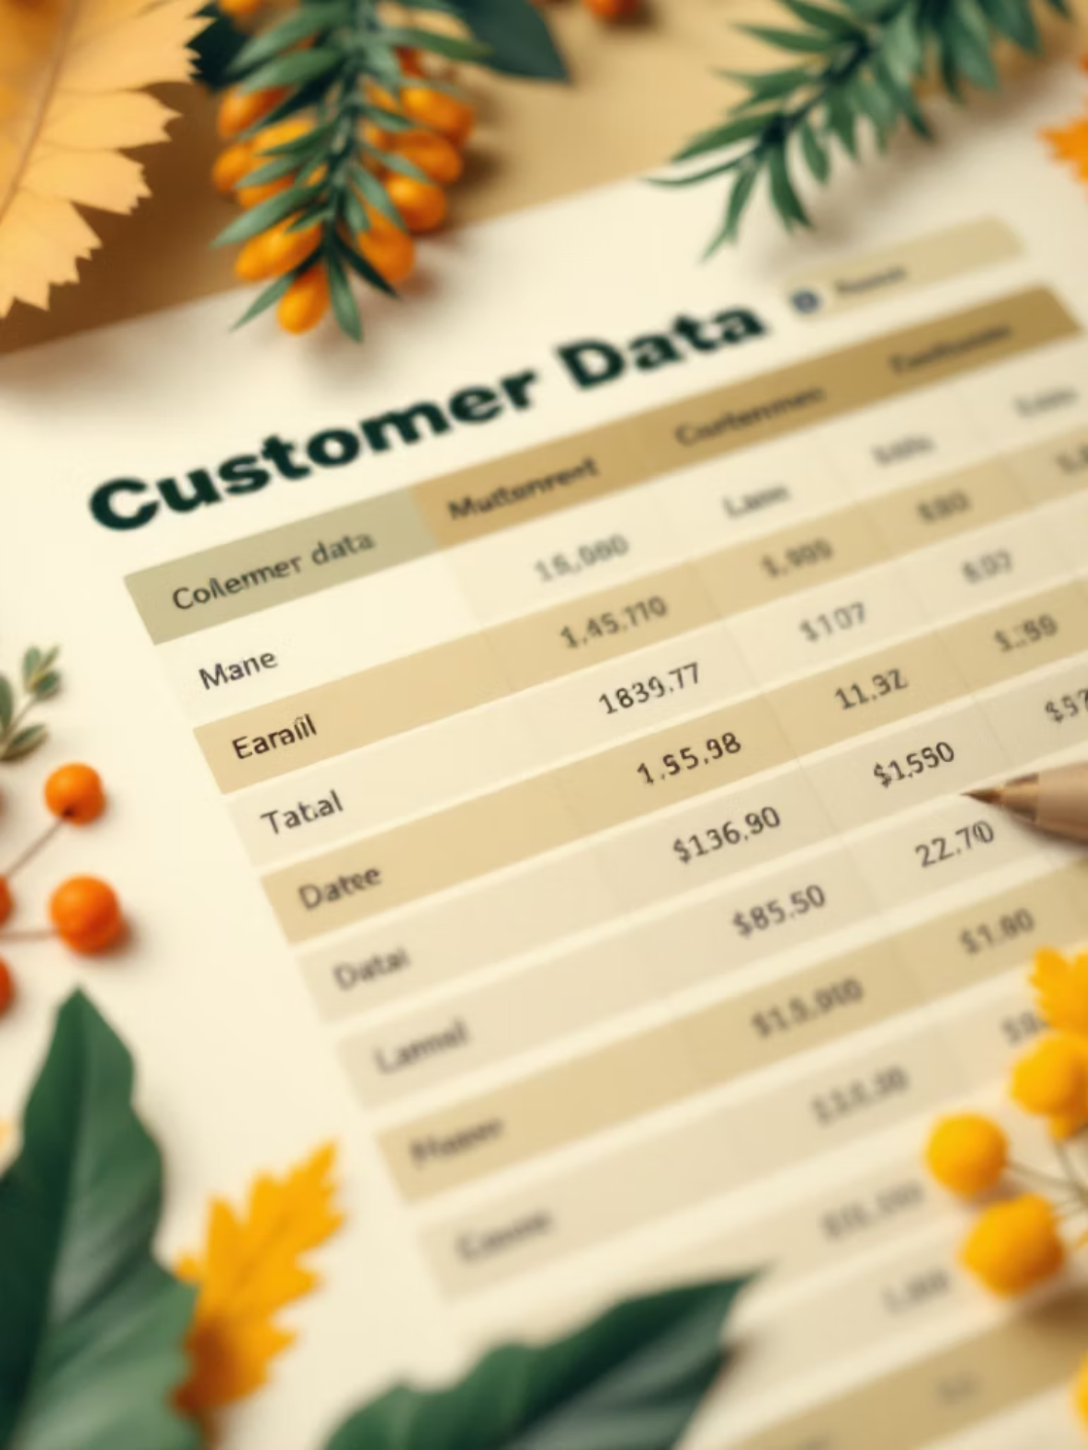
Dataset Snapshot
Key fields
Customer ID
Gender
Age Group
Category
Subscription Status
Purchase Amount
Review Rating

Slide 4

Key KPIs
3.9K
$59.76
3.75
Total Customers
Avg Purchase
Avg Rating
Number of unique customers in dataset.
Average purchase amount per transaction.
Average review rating across products.

Slide 5

Subscription Analysis
Current Split
73% Customers Not Subscribed • 27% Customers Subscribed
Opportunity: increase subscription conversion through targeted campaigns and offers.

Slide 6




Revenue by Category
Clothing
Accessories
Footwear
Outerwear
Highest Revenue — primary driver of sales.
Moderate revenue contribution.
Important category with steady sales.
Lowest revenue — clear growth opportunity.

Slide 7

Revenue by Age Group
Young Adults
Highest revenue — primary customer segment.
Middle-aged
Strong contribution to sales.
Adults
Moderate contribution.
Seniors
Lowest contribution — potential niche marketing target.

Slide 8

Business Insights
Customer Drivers
Young adults are key revenue drivers; clothing dominates sales.
Subscription & Ratings
Low subscription percentage (27%) and average rating (3.75) indicate improvement areas.
Category Opportunities
Outerwear and product quality are clear areas to boost marketing and upgrades.

Slide 9


Recommendations
Target Young Adults
Personalized offers and promotions to increase spend and retention.
Increase Subscriptions
Run conversion campaigns and trial incentives to grow subscription base.
Improve Product Quality
Enhance product checks and supplier standards to lift ratings.
Boost Outerwear Marketing
Specialized campaigns to raise awareness and revenue in lowest-performing category.

Slide 10

Technical Implementation
Power BI — dashboard creation & interactive filters
SQL (PostgreSQL) — data cleaning and transformation
Python (pandas) — analysis and preprocessing
DAX — KPI calculations and measures
Combine these tools to deliver a responsive, filterable dashboard that supports segmentation and executive reporting.

Slide 11

Customer Segmentation Strategy
High-Value Young Adults
Characteristics: Primary revenue drivers, fashion-conscious, engage frequently with clothing and accessories.
Personalized offers and trend-driven promotions.
Develop loyalty programs and exclusive access to new collections.
Engage through social media and influencer marketing.
Subscription-Ready Customers
Characteristics: Show engagement (e.g., frequent purchases) but are not yet subscribed. High potential for conversion.
Targeted campaigns highlighting subscription benefits (e.g., free shipping, discounts).
Offer limited-time trial incentives for subscription services.
Showcase positive testimonials from current subscribers.
Quality-Conscious Buyers
Characteristics: Value product quality and reliability, influenced by product reviews, and contribute to higher average ratings.
Emphasize product craftsmanship and material quality in marketing.
Showcase strong customer reviews and product ratings prominently.
Introduce premium product lines with enhanced features and durability.
Emerging Segments
Characteristics: Groups with currently low revenue contribution (e.g., Seniors, Outerwear), representing untapped growth potential.
Conduct niche marketing campaigns tailored to specific demographics or product categories.
Explore product development opportunities to meet their unique needs.
Implement targeted promotions to raise awareness and drive initial purchases.

